Slide 1
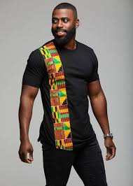
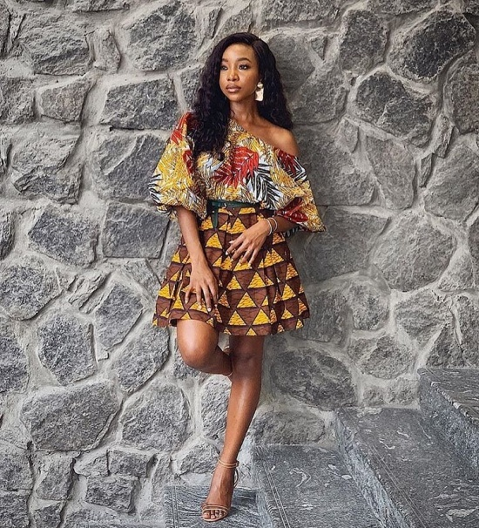
DESIGN FUSION
Presented by:
Team i-Trans
(Michael, Joy, Peace, Sodiq, Adeola, Rufia & Seyi )

Slide 2

COMPANY BACKGROUND
Design Fusion is an initiative born by the desire of seven i-Trans members to reduce the cumbersome process of getting ready-made and finished designs.
Our company started in 2019 with a view to ensuring rapid delivery of fabric materials and ready-made designs.
Eventually, plans were later made to include the delivery of quality African prints and fabrics to various parts of the world.

Slide 3

MISSION STATEMENT
We have a mission to provide a platform that provides ease and comfort to fashion lovers around the world, and through which we can achieve SDG goals of Decent Work, Economic Growth, Industry, Innovation, etc.

Slide 4
PRODUCT/SERVICE DESCRIPTION
A platform for designers and fashion lovers to connect.
Sales and export of African prints and fabrics.
An advertising platform on the DESIGNFUSION.COM website.

Slide 5
WHAT WE OFFER
The Problems
Failure of fashion designers to meet deadlines.
Inability of clients with busy schedules to meet with fashion designers.
Inability to get professional fashion designers for certain designs/styles within certain geographical locations.
Our Solutions
Creating a medium where fashion lovers can meet with professional fashion designers.
Shorten the burden for fashion lovers with very busy schedules
Creating an online fashion platform to sell and buy African prints.

Slide 6

VALUE PROPOSITION
Convenience
Quality Fabrics & Designs
Safety
Delivery Care Package
I-Trans Foundation
Industry Innovation
Increased Employment

Slide 7

MARKETING & SALES STRATEGY
Targeted Ads (Facebook Ads, Twitter Ads).
Advertising on other top sites.
Referrals programme.
Prints and fliers

Slide 8


COMPETITION
Our Competitors
360creative hub: A fashion learning and co-working space for designers.
Fashion outlets that have a strong online presence.

Slide 9
SWOT ANALYSIS
STRENGTHS Team members with knowledge of the fashion industry and great relational skills. Access to wide scope of fashion designers Relevant database to boost designers’ interaction. Ability to reach several tons of customers through social media. | WEAKNESSES Lack of adequate funds/capital. Limited manpower for smooth and efficient distribution. Convincing designers to get involved.
OPPORTUNITIES Social media advancement Very little competition Absence of trade law prohibiting export of fabric materials. Hundreds of fashion shows available to take advantage of. | THREATS Sudden influx/emergence of more competitors. Reduction in standard of living. Low economic development. Government regulations prohibiting/restricting export of African fabrics.

Slide 10
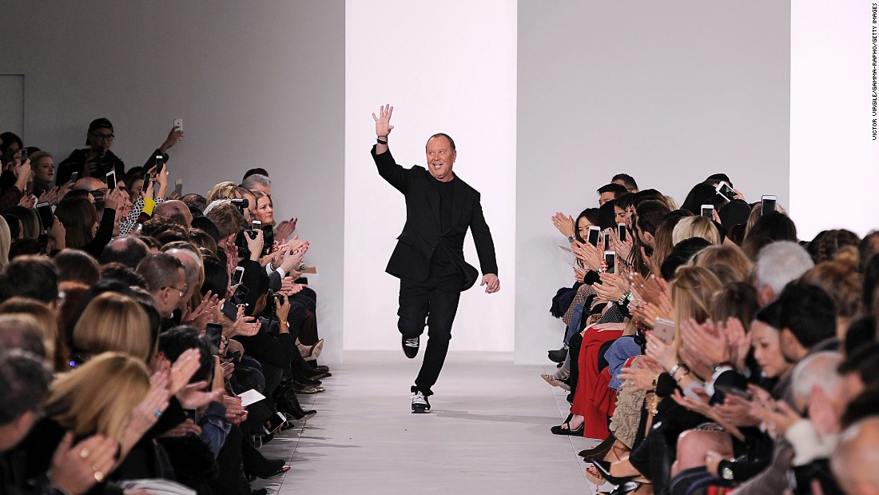
WELCOME ON BOARD!

Slide 11
FINANCIAL PROJECTIONS
ITEMS | DESCRIPTION | AMOUNT(#) | QUANTITY | TOTAL(#)
Fliers | Advertisement | 50 | 1,000 | 50,000
Internet Data | Data consumed monthly | 5,000 | 10GB Quarterly | 25,000
Transportation | Creating awareness | 10,000 | 4 Trips | 40,000
Electricity Bills | Electricity | 15,000 | Quarterly | 45,000
Maintenance | Operations |  |  | 500,000
Web Hosting | Web hosting |  | Per-annum | 70,000
Miscellaneous | Other expenses |  |  | 100,000
Online Ads | Awareness |  |  | 20,000
 |  |  |  | 850,000

Slide 12
REVENUE
Amt(#m)
Time(yr)

